Slide 1
Parkinson’s Disease Predictions based on Voice Data
Jay Soto

Slide 2
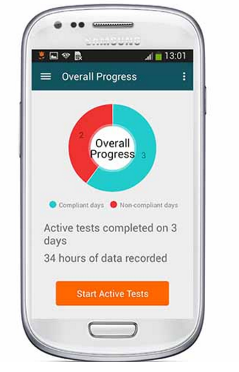
Who am I….and why PD?
I work for Prothena Biosciences
Currently developing PRX002 as a potential disease modifying treatment for Parkinson’s disease
Parkinson's Disease Smartphone App

Slide 3
Hypothesis/Goal
There are distinct trademarks of a PD patient’s voice, so I would like to develop a model that predicts whether someone has Parkinson’s disease or not….solely on the characteristics of their voice

Slide 4
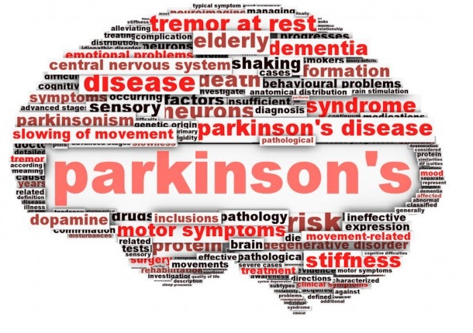
Approximately 7-10 million currently living with a PD diagnosis
60K diagnosed in the US every year
Currently no cure, with only temporary symptomatic treatments approved (L-Dopa)

Slide 5
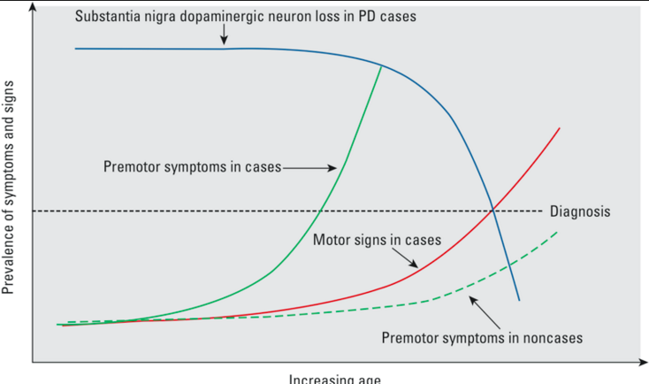
Symptoms, and underlying disease, worsen over time…..long before diagnosis
No known biomarker/diagnostic (e.g, blood test, imaging agent, etc)
In order to alter the course of the disease, earlier diagnosis and intervention is likely required

Slide 6
Parkinson’s Disease
A few motor symptoms:
Rigidity: stiffness of the trunk, limbs neck, etc.
Resting Tremors: usually in the hands/feet
Bradykinesia: slowness of movement
Postural Instability: tendency to be unstable while upright
Increase difficulty in speaking

Slide 7
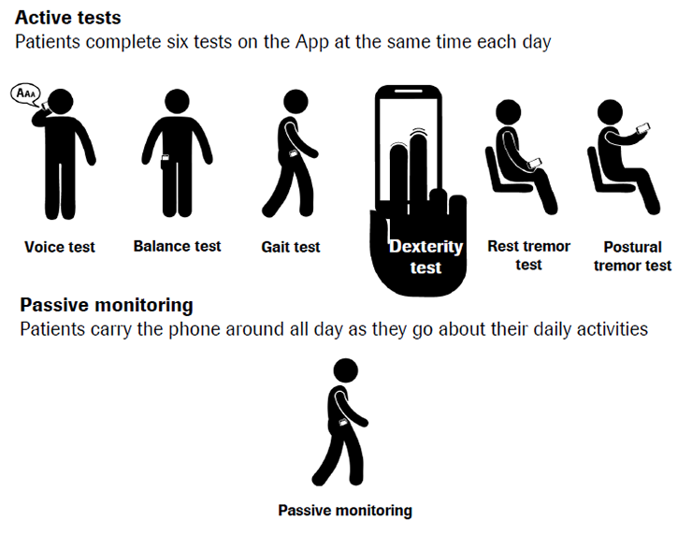

Slide 9
The Data
Provided by a Max Little, PhD (University of Oxford, TED talk participant)
Data from 31 individuals:
23 Parkinson’s disease patients
8 healthy controls
A total of 195 voice recordings
147 Parkinson’s disease patients
48 healthy controls

Slide 10
The Data
Features (n = 22) | Description
MDVP:Fo(Hz) | Average vocal fundamental frequency
MDVP:Fhi(Hz) | Maximum vocal fundamental frequency
MDVP:Flo(Hz) | Minimum vocal fundamental frequency
MDVP:Jitter(%), MDVP:Jitter(Abs), MDVP:RAP, MDVP:PPQ,Jitter:DDP | Several measures of variation in fundamental frequency
MDVP:Shimmer, MDVP:Shimmer(dB), Shimmer:APQ3, Shimmer:APQ5, MDVP:APQ, Shimmer:DDA | Several measures of variation in amplitude
NHR, HNR | Two measures of ratio of noise to tonal components in the voice
RPDE, D2 | Two nonlinear dynamical complexity measures
DFA | Signal fractal scaling exponent
spread1, spread2, PPE | Three nonlinear measures of fundamental frequency variation
status | Health status of the subject (one) - Parkinson's, (zero) - healthy

Slide 11
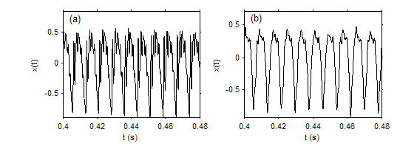
What are we looking at?
Healthy Control
Parkinson's Patient

Slide 12
Model Selection
Model | Cross Validation Score
Logistic Regression | 0.80883265857
Random Forest Classifier - (max_depth=5, n_estimators = 1000) | 0.789230769231
Bernoulli Naïve Bayes | 0.753981106613
Gaussian Naïve Bayes | 0.691470985155
Ensemble | 0.803967611336
KNN | 0.901102489940
Logistic Regression | 0.911928389291
Decision Trees | 0.919292889330
……a good starting point

Slide 13
Random Forest
Random Forest with Boosting
Utilized Out of Bag observations for tuning but Cross Validation for testing
Self selected Parameters:
Lambda = 0.01,
n_estimators = 1000
max_depth = 5
Result: 0.908
Misclassification: 0.092

Slide 14
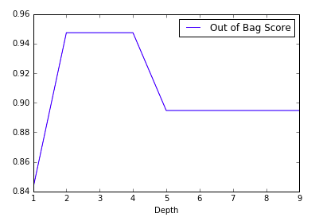
Random Forest
Tuning for max depth
Parameters:
n_estimators = 1000
Lambda = 0.01
Max depth of 2 selected

Slide 15
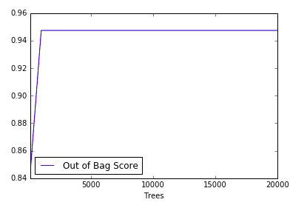
Random Forest
Tune for n_estimators (Trees)
Range 1,000-20,000
Parameters:
Lambda = 0.01
max_depth = 5
Further turning required

Slide 16
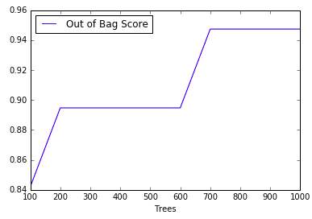
Random Forest
Tune for n_estimators (Trees)
Range 100-1,000
Parameters:
Lambda = 0.01
max_depth = 5
n_estimators of 700 selected

Slide 17
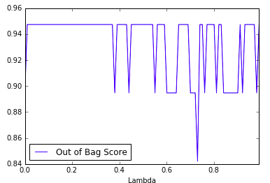
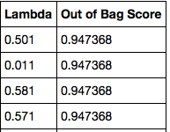
Random Forest
Tune for Lambda
Range 0.001-1.0
Parameters:
n_estimator = 700
max_depth = 5
Lambda of 0.581 selected

Slide 18
Random Forest
Cross Validation with updated parameters:
Lambda = 0.5811,
n_estimators = 700
max_depth = 5
Result: 0.955
Misclassification: 0.045
1 | 2 | 3 | 4 | 5 | 6 | 7 | 8 | 9 | 10
0.95 | 0.9 | 0.95 | 0.95 | 0.9 | 1.0 | 1.0 | 1.0 | 0.947 | 0.947

Slide 19
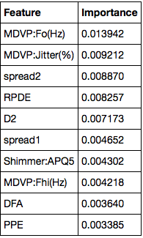
Random Forest
Confusion Matrix
Predicted
 | 0- Healthy | 1- PD
0- Healthy | 47 | 1*
1- PD | 0 | 147
Actual
* One healthy control was predicted as a PD patient (false positive)

Slide 20
Discussion
Of all of the supervised learning techniques attempted, Random Forests with Boosting performed the best
Utilizing Boosting and after tuning my model, I was able to pick up an additional 16.6% accuracy from Random Forest (from 78.9 to 95.5%)

Slide 21
Next Steps
Evaluate whether PD can be differentiated from other diseases, (e.g., Multiple Sclerosis) where similar voice disturbances occur
Aggregate voice data with other PD data sets (e.g., gait, tremor, postural instability)
Evaluate if voice data can pick-up treatment effects and be used for diagnosis
Collect more data!!!!
If interested to support, go to: http://www.parkinsonsvoice.org

Slide 22
Thank you!!
Any questions??

